Slide 1
Measuring Forces
Year 7 Science

Slide 2
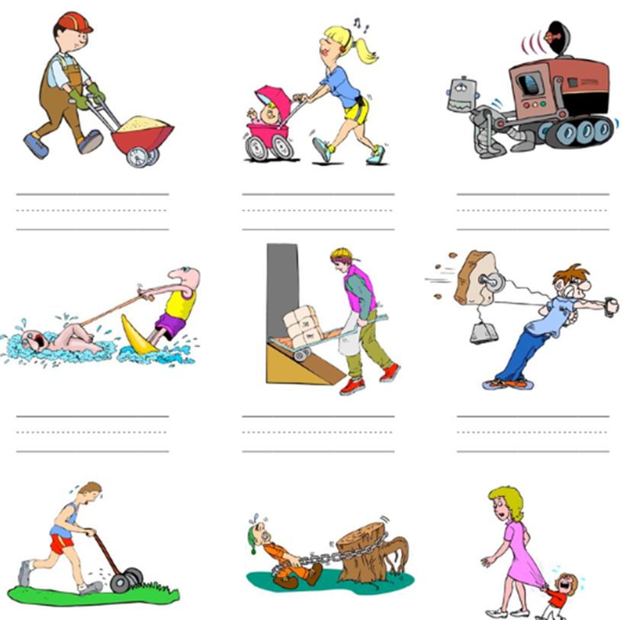

Review
Push or pull?

Slide 3
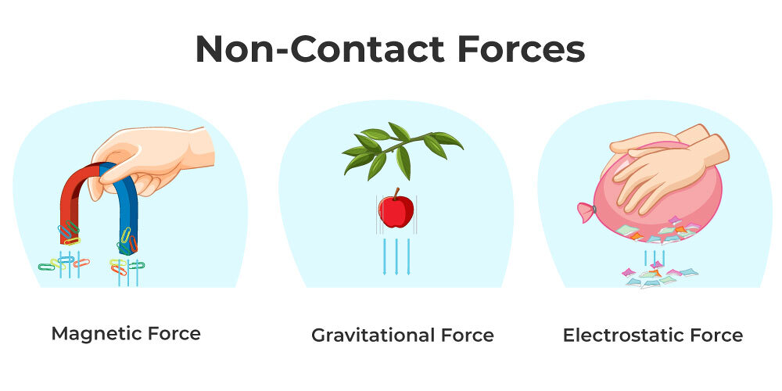

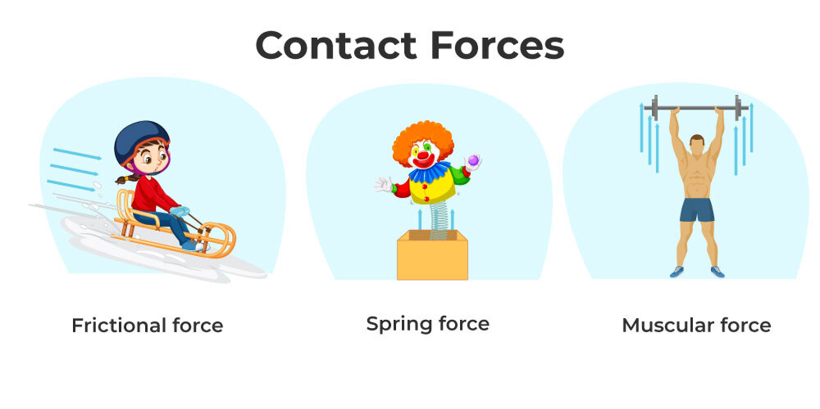
Review
Contact or non-contact?

Slide 4
Learning Intentions
Change to an object’s motion is caused by unbalanced forces acting on the object.
investigating the effects of applying different forces to familiar objects

Slide 5
Success criteria
Measure forces in Newtons.
Compare/convert Newtons to kg.
Use equipment to measure forces.

Slide 6
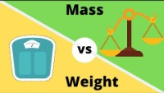

Slide 7
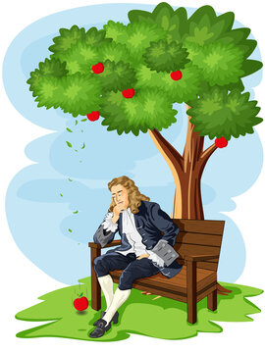
Newtons
On Earth
1 N = 100g
(the weight/mass of an apple)
Gravity is 10 m/s²

Slide 8
Convert to Newtons…
1 kg
10 kg
50kg
1 x 10
= 10 N
10 x 10
= 100 N
50 x 10
= 500 N

Slide 9
Convert to Kg
20 N
400 N
1000 N
20 ÷ 10
= 2 kg
400 ÷ 10
= 40 kg
1000 ÷ 10
= 100 kg

Slide 10
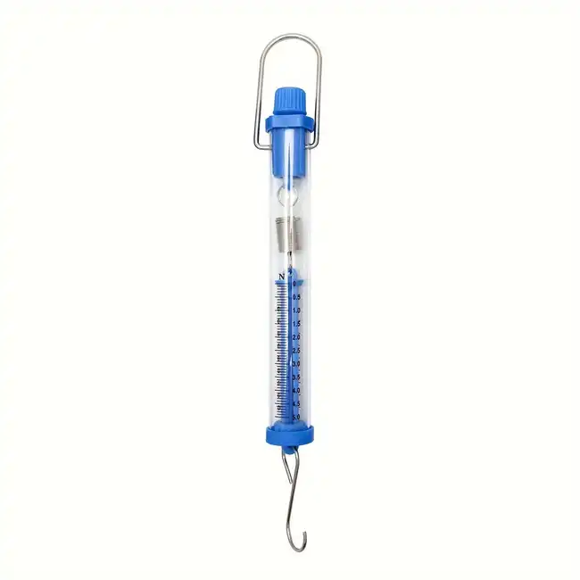
How do we measure forces?

Slide 11
Experiment: Measuring Forces

Slide 12
Success criteria
Measure forces in Newtons.
Compare/convert Newtons to kg.
Use equipment to measure forces.

